Slide 1

Drama At Cornwallis Academy
Year 8 – LESSON 6
Lesson Objective:
-To demonstrate an understanding of how to use acting skills in performance.
-To demonstrate an understanding of how to devise and perform and Murder Mystery.
Success Criteria:
Performing and Creating
Level 4
I can stay in role for good parts of my performance, occasionally struggling to keep focused. I will make a reasonable contribution to my groups work, sharing some simple ideas.
Level 5
I can stay in role for most of the performance with few distractions. I will make a positive contribution to a group, sharing ideas and showing some leadership.
Level 6
I can consistently stay in role for the whole of the performance. I Contribute ideas very well to the group I’m in and am capable of showing good leadership skills.

Slide 2
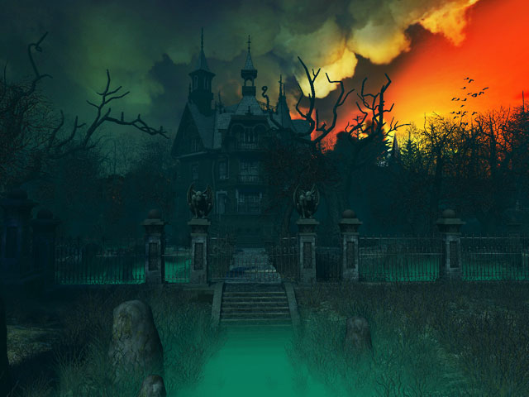
Lesson Objective:
-To demonstrate an understanding of how to use acting skills in performance.
-To demonstrate an understanding of how to devise and perform and Murder Mystery. .
Activity 1 – Murder Mystery game 6 – Who is the murderer?
WILF:
Performing and Creating
Level 4
I can stay in role for good parts of my performance, occasionally struggling to keep focused. I will make a reasonable contribution to my groups work, sharing some simple ideas.
Level 5
I can stay in role for most of the performance with few distractions. I will make a positive contribution to a group, sharing ideas and showing some leadership.
Level 6
I can consistently stay in role for the whole of the performance. I Contribute ideas very well to the group I’m in and am capable of showing good leadership skills.

Slide 3
Lesson Objective:
-To demonstrate an understanding of how to use acting skills in performance.
-To demonstrate an understanding of how to devise and perform and Murder Mystery.
Warm-up – Concentration character exercise
You will need to get sat on the floor in a space on your own. You will be instructed to close your eyes and think about the following questions in your head:
(1)Who are you? (2) How old are your? (3) What is your role in the story? (4) How do you feel about the situation you are in etc…?
Success Criteria:
Performing and Creating
Level 4
I can stay in role for good parts of my performance, occasionally struggling to keep focused. I will make a reasonable contribution to my groups work, sharing some simple ideas.
Level 5
I can stay in role for most of the performance with few distractions. I will make a positive contribution to a group, sharing ideas and showing some leadership.
Level 6
I can consistently stay in role for the whole of the performance. I Contribute ideas very well to the group I’m in and am capable of showing good leadership skills.

Slide 4
Murder Mystery Assessment
You will have 5 minutes to rehearse your Murder Mystery plays and make sure that you have all the correct equipment and that you have your stage set out as you need it.
Lesson Objective:
-To demonstrate an understanding of how to use acting skills in performance.
-To demonstrate an understanding of how to devise and perform and Murder Mystery.
Success Criteria:
Performing and Creating
Level 4
I can stay in role for good parts of my performance, occasionally struggling to keep focused. I will make a reasonable contribution to my groups work, sharing some simple ideas.
Level 5
I can stay in role for most of the performance with few distractions. I will make a positive contribution to a group, sharing ideas and showing some leadership.
Level 6
I can consistently stay in role for the whole of the performance. I Contribute

Slide 5

Murder Mystery Assessment
Task 1 – Performing skills
As a class we will need to use the performance skills card provided to pick the 5 most important skills to look for within each assessment. Each of you will need to then make a wish for the lesson to enable you to achieve your full potential- this enables you to individually highlight your weaknesses to help you to achieve a higher grade than you are currently on.
Lesson Objective:
-To demonstrate an understanding of how to use acting skills in performance.
-To demonstrate an understanding of how to devise and perform and Murder Mystery.
Success Criteria:
Performing and Creating
Level 4
I can stay in role for good parts of my performance, occasionally struggling to keep focused. I will make a reasonable contribution to my groups work, sharing some simple ideas.
Level 5
I can stay in role for most of the performance with few distractions. I will make a positive contribution to a group, sharing ideas and showing some leadership.
Level 6
I can consistently stay in role for the whole of the performance. I Contribute

Slide 6
Task 2 – Performing your Murder Mystery
You will all need to sit in 2 straight lines to form the audience. Each group will be called up to do their performance. Each group will be recorded by video to evidence your work.
Recap - what makes a good audience member and what are the expectations?
Murder Mystery Assessment
Lesson Objective:
-To demonstrate an understanding of how to use acting skills in performance.
-To demonstrate an understanding of how to devise and perform and Murder Mystery.
Success Criteria:
Performing and Creating
Level 4
I can stay in role for good parts of my performance, occasionally struggling to keep focused. I will make a reasonable contribution to my groups work, sharing some simple ideas.
Level 5
I can stay in role for most of the performance with few distractions. I will make a positive contribution to a group, sharing ideas and showing some leadership.
Level 6
I can consistently stay in role for the whole of the performance. I Contribute

Slide 7
Task 2 – Performing your Murder Mystery
You will now all perform your pieces to the rest of the class. After each performance we will pick a strength and weakness for each performer. You will need to pick one of the key words that you feel best demonstrates what you have just seen.
Murder Mystery Assessment
Lesson Objective:
-To demonstrate an understanding of how to use acting skills in performance.
-To demonstrate an understanding of how to devise and perform and Murder Mystery.
Success Criteria:
Performing and Creating
Level 4
I can stay in role for good parts of my performance, occasionally struggling to keep focused. I will make a reasonable contribution to my groups work, sharing some simple ideas.
Level 5
I can stay in role for most of the performance with few distractions. I will make a positive contribution to a group, sharing ideas and showing some leadership.
Level 6
I can consistently stay in role for the whole of the performance. I Contribute

Slide 8
REFLECTION
Questions and Answers
What were your strengths and why?
What were your weaknesses and why?
What level did you achieve and why?
Murder Mystery Assessment
Lesson Objective:
-To demonstrate an understanding of how to use acting skills in performance.
-To demonstrate an understanding of how to devise and perform and Murder Mystery.
Success Criteria:
Performing and Creating
Level 4
I can stay in role for good parts of my performance, occasionally struggling to keep focused. I will make a reasonable contribution to my groups work, sharing some simple ideas.
Level 5
I can stay in role for most of the performance with few distractions. I will make a positive contribution to a group, sharing ideas and showing some leadership.
Level 6
I can consistently stay in role for the whole of the performance. I Contribute

